Slide 1

Ahmed Abir Choudhury, Lecturer
Brac University

Slide 2
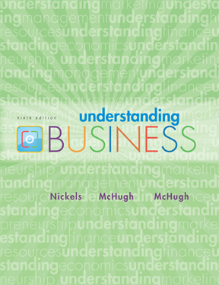
*
Chapter Seventeen
*
Understanding Accounting and Financial Information
McGraw-Hill/Irwin
Copyright © 2010 by The McGraw-Hill Companies, Inc. All rights reserved.

Slide 3
WHAT’S ACCOUNTING?
*
What is Accounting?
*
LG1
Accounting -- Recording, classifying, summarizing and interpreting of financial events and transactions in an organization to provide interested parties needed financial information.
Outside parties - like employees, owners, creditors, unions, investors and the government - make use of a firm’s accounting information.
17-<number>

Slide 4
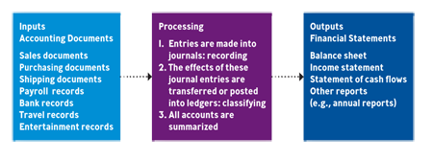
The ACCOUNTING SYSTEM
*
What is Accounting?
*
LG1
17-<number>

Slide 5
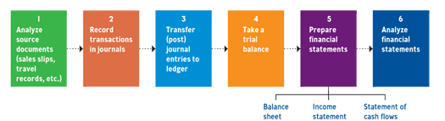
The ACCOUNTING CYCLE
*
The Accounting Cycle
*
LG3
Accounting Cycle -- A six-step procedure that results in the preparation and analysis of the major financial statements.
17-<number>

Slide 6
BOOKKEEPING’S ROLE
*
The Accounting Cycle
*
LG3
Bookkeeping -- The recording of business transactions. Bookkeepers divide a firm’s transactions into meaningful categories and post them into a record book or computer program called a journal.
Double-Entry Bookkeeping -- Bookkeepers record all transactions in two places so they can check one list of transactions against the other for accuracy.
17-<number>

Slide 7

FINANCIAL STATEMENTS
*
Understanding Key Financial Statements
*
LG3
Financial Statement -- A summary of all the financial transactions that have occurred over a particular period.
Key financial statements of business are:
  Balance sheet
  Income statement
  Statement of cash flows
17-<number>

Slide 8
The FUNDAMENTAL
ACCOUNTING EQUATION
*
The Fundamental Accounting Equation
*
LG4
Fundamental Accounting Equation -- The basis for the balance sheet.
The equation must always be balanced and includes the formula:
  Assets = Liabilities + Owners Equity
17-<number>

Slide 9

USING FINANCIAL RATIOS
*
Analyzing Financial Performance Using Ratios
*
LG5
Ratio Analysis -- The assessment of a firm’s financial condition using calculations and financial ratios developed from the firm’s financial statements.
Key ratios include:
  Liquidity ratios
  Leverage ratios
  Performance ratios
  Activity ratios
17-<number>

Slide 10

COMMONLY USED
LIQUIDITY RATIOS
*
Liquidity Ratios
*
LG5
Liquidity ratios measure a firm’s ability to turn assets into cash to pay its short-term debts.
Two key ratios are:
  Current ratio
  Acid-test ratio
  This information is found on the firm’s balance sheet.
17-<number>

Slide 11

LEVERAGE RATIOS
*
Leverage (Debt) Ratios
*
LG5
Leverage ratios measure the degree to which a firm relies on borrowed funds in its operations.
Key ratios include:
  Debt to Owner’s Equity Ratio
  This information is found on the firm’s balance sheet.
17-<number>

Slide 12


PROFITABILITY RATIOS
*
Profitability (Performance) Ratio
*
LG5
Profitability ratios measure how effectively a firm’s managers are using it various resources to achieve profits.
Key ratios include:
  Basic earnings per share
  Return on sales
  Return on equity
17-<number>

Slide 13

ACTIVITY RATIOS
*
Activity Ratio
*
LG5
Activity ratios measure how effectively management is turning over inventory
Key ratios include:
  Inventory turnover ratio
  This information is found on the firm’s balance sheet and income statement.
17-<number>

